Slide 1
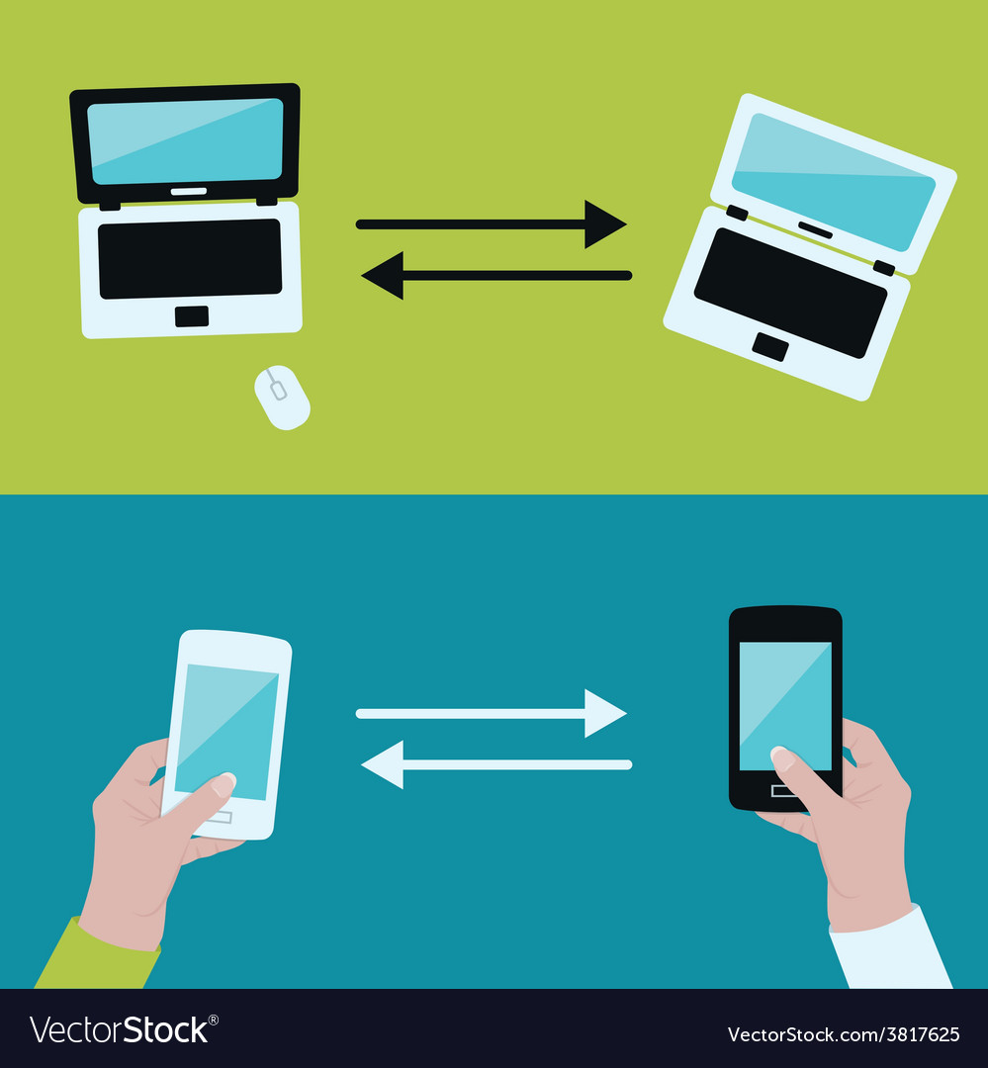
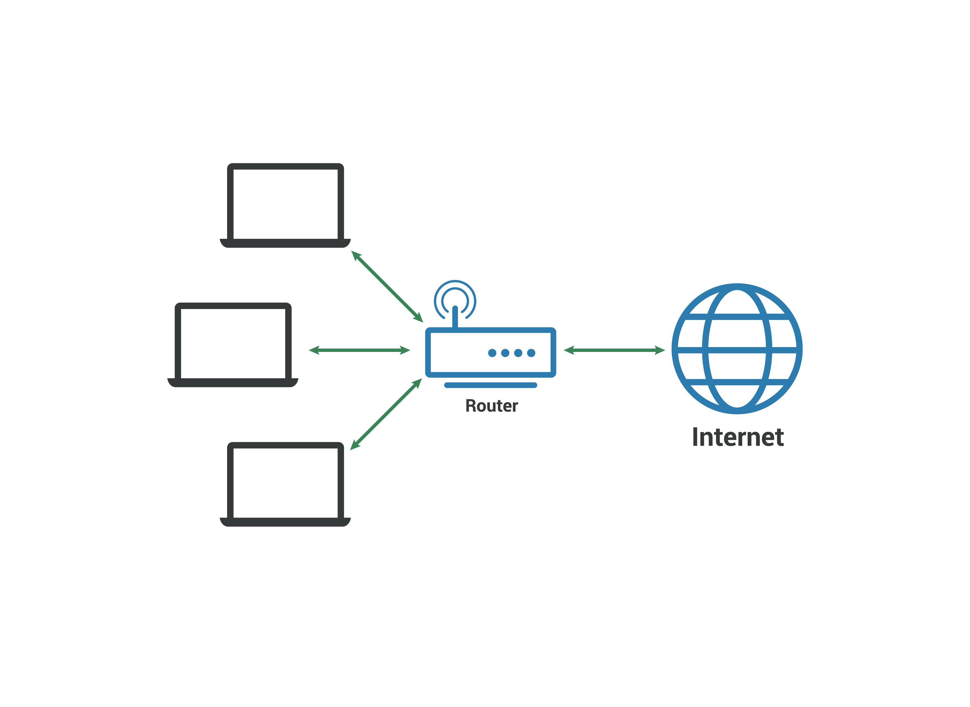
DEVICE DISCOVERY IN D2D COMMUNICATION
PROJECT GUIDE :
Mr. S. Devarajsamy Selvan,ME.,
(Assistant professor /IT )
TEAM MEMBERS :
Boopalan G
Giri S
Shathivel Murugan S
Yogesh E

Slide 2
ABSTRACT
Device-to-Device (D2D) correspondence in cell networks is characterized as immediate correspondence between two versatile clients without navigating the Base Station (BS) or center organization.
D2D correspondence is by and large non-straightforward to the cell organization and it can happen on the cell frequencies (i.e., in band) or unlicensed range (i.e., outband).
In a conventional cell organization, all interchanges should go through the BS regardless of whether conveying parties are in range for vicinity based D2D correspondence.
Correspondence voice call and text informing in which clients are only occasionally close enough for direct correspondence.

Slide 3

LITERATURE REVIEW A Novel Multi-Hop Routing Protocol for D2D Communications in 5G
Rana E. Ahmed has proposed this paper Intelligent transportation frameworks are intended to give imaginative applications and administrations.
To achieve an effective utilization of available resources, reduce latency, improve data rates, and increase system capacity, D2D communication utilizes nearby communicating devices
D2D communications,
5G,
Multi-hop Routing,
Dynamic Source Routing (DSR)

Slide 4
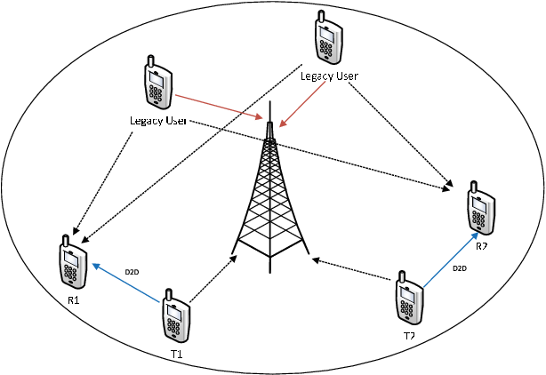
LITERATURE REVIEW Discovery Signal Design and Its Application to Peer-to-Peer Communications in OFDMA Cellular Networks
Michael. Wang, and C. Jiang has proposed this paper Intelligent transportation frameworks are intended to give imaginative applications and administrations.
Proposes a unique discovery signal as an enabler of peer-to-peer (P2P) communication which overlays a cellular network and shares its resources.
Peer-to-peer networks,
neighbor discovery signals,
OFDMA cellular networks

Slide 5
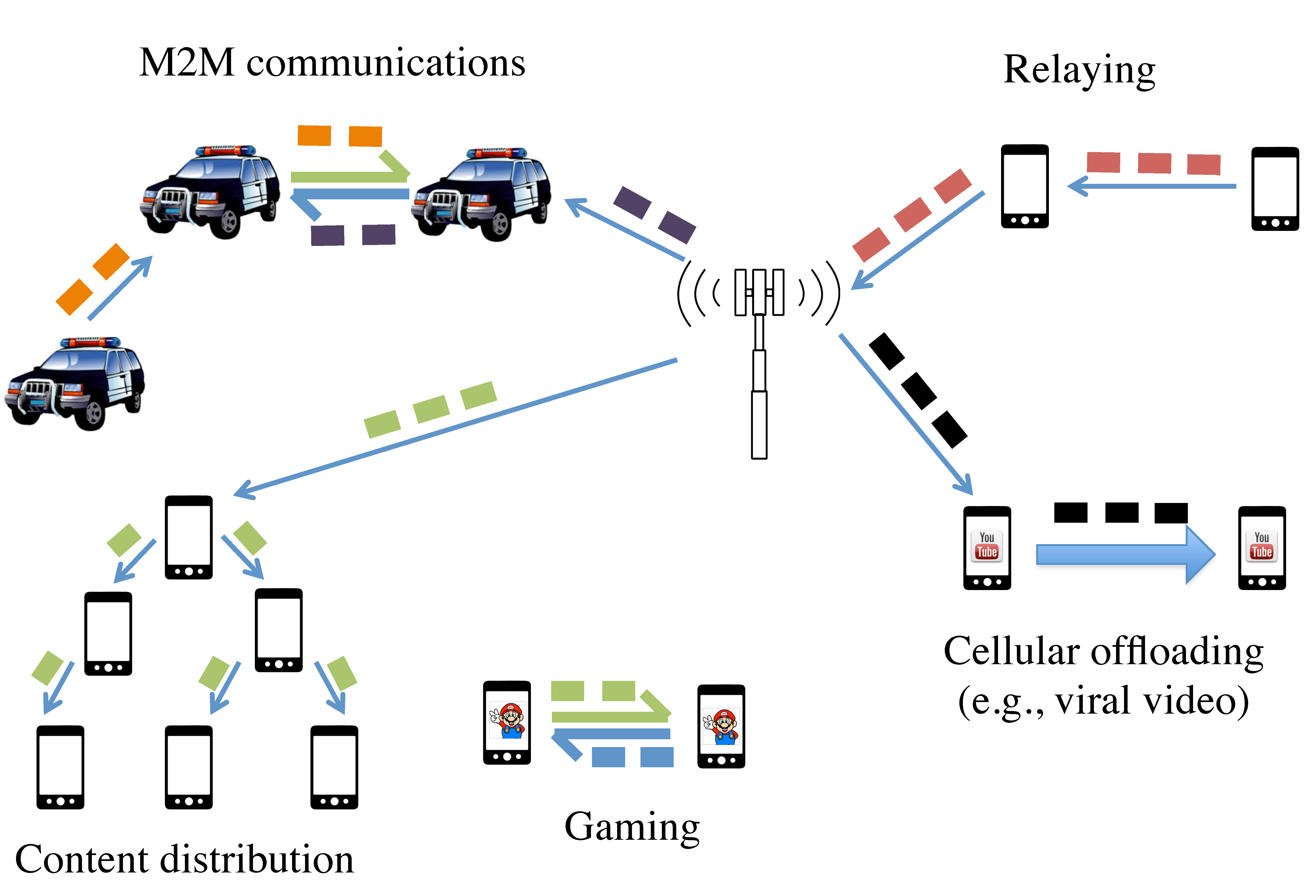
A Survey on Device-to-Device Communication in Cellular Networks
LITERATURE REVIEW
Arash Asadi, Student Member, IEEE, Qing Wang, Student Member, IEEE, and Vincenzo Mancuso, Member, IEEE has proposed this paper Intelligent transportation frameworks are intended to give imaginative applications and administrations
Device-to-Device (D2D) communication was initially proposed in cellular networks as a new paradigm to enhance network performance.
Device-to-Device communication,
Cellular networks,
LTE,
LTE-A

Slide 6

Green Random Access for Wireless Peer Discovery
LITERATURE REVIEW
Taesoo Kwon, Member, IEEE has proposed this paper Intelligent transportation frameworks are intended to give imaginative applications and administrations
This letter investigates the joint design problem of transmission probability (v) and transmit power (p) in random access-based wireless peer discovery (RA-WPD) operations, in terms of reducing the power consumption of the peers.
Peer discovery,
energy saving,
power control,
random access,
stochastic geometry,
D2D networks.

Slide 7
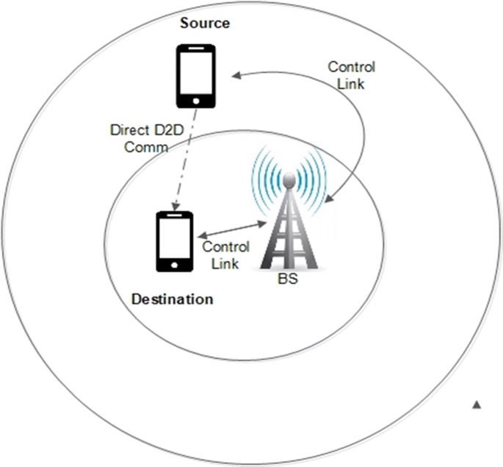
Connectivity of Cognitive Device-to-Device Communications Underlying Cellular Networks
LITERATURE REVIEW
Mohammad G. Khoshkholgh, Yan Zhang, Senior Member, IEEE, Kwang-Cheng Chen, Fellow, IEEE,Kang G. Shin, Life Fellow, IEEE, and Stein Gjessing has proposed this paper Intelligent transportation frameworks are intended to give imaginative applications and administrations
However, such device-to-device (D2D) communications create a new type of interference in cellular systems
Cellular networks,
coverage probability,
interference threshold constraint,
collision probability constraint,
percolation,

Slide 8


ON SERVICE DISCOVERY IN MOBILE SOCIAL NETWORKS: SURVEY AND PERSPECTIVES
LITERATURE REVIEW
Mobile social networks represent a convergence between mobile communications and service-oriented paradigms, which are supported by the large availability and heterogeneity of resources and services offered by recent mobile devices.
In particular, the service-oriented nature of MSN is in the capability of sharing resources and services among devices that lie in proximity and that opportunistically interact.

Slide 9
EXISTING SYSTEM
In the existing system the other methodologies like the wireless position estimation , neighbor route discovery , out band , energy efficiency , discovery latency , mobility , 5g enhanced.
This methods gave the opportunity to lead the future industrial research either in one or more categories.
Results in loss in energy and excessive time delay .

Slide 10
PROPOSED SYSTEM
Pso (particle swarm optimization) is used as the proposed methodology in our system .
we provide high efficiency system infrastructure with the help of pso resulting that in band , out band , energy efficiency , discovery latency , mobility , 5g are enhanced resulting in various .
communication between the various devices are optimized so that the communication is enhanced with the high level of security.

Slide 11
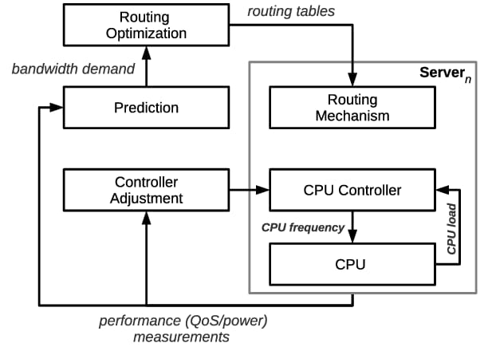
SYSTEMFLOW DIAGRAM

Slide 12

LIST OF MODULES
Clusters Formation
Number Of Clusters And Ch-density
Clustering During Each Round For Selecting The Cluster Heads(data Sensing)
Cluster Formation Required After Each Rotation Of Cluster Head (Intra Routing And Extra Routing)
Distribution Of Cluster Heads Over The Network

Slide 13
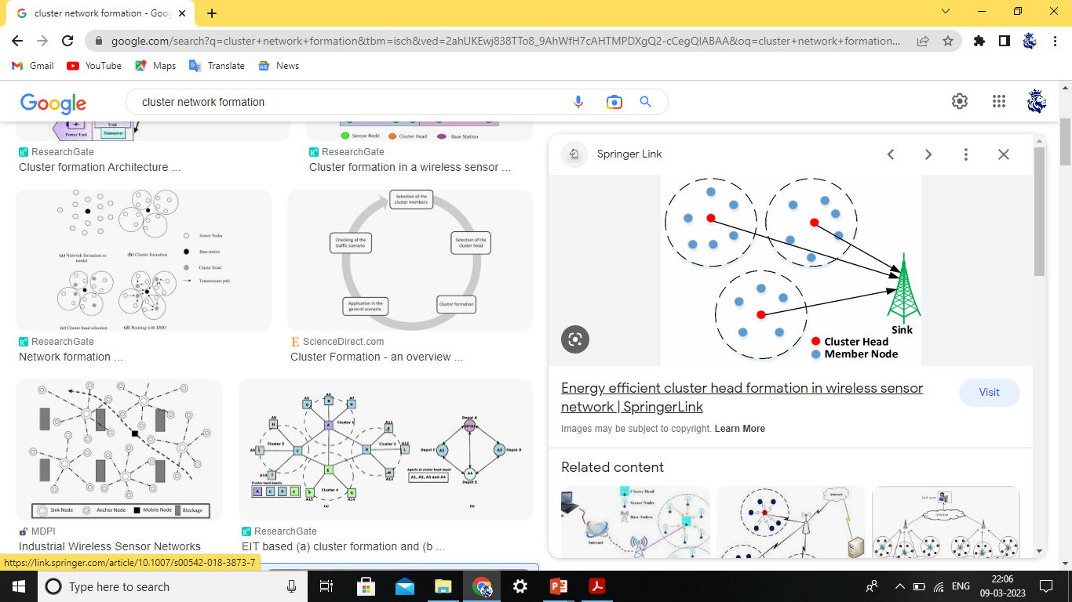
Clusters Formation
We can see that the distribution of the cluster sizes is highly uneven between the clusters: four clusters (25% of the total clusters) have a size more than double that of the other clusters.
Thus, the CHs of those large clusters may encounter traffic congestion.
It is worth noting that, because of the border effects, than nodes in the border’s vicinity.

Slide 14
Number Of Clusters And Ch-density
Distributed clustering is a robust technique used to organize ad hoc deployed wireless nodes to form a communication network.
A widely adopted in energy constrained ad hoc deployed wireless sensor networks.
The reliability is directly connected to the redundancies associated with the nodes within a cluster.
The probability distribution of the cluster area is consider to the boundary .
The node with the highest fitness to become a CH

Slide 15
Cluster Formation Required After Each Rotation Of Cluster Head (Intra Routing And Extra Routing)
The minimum number of hops might constitute such a metric that could be used to compute a shortest path through a network.
In the intra routing the each sub nodes is connected to the internal connection with the user nodes in each and every clusters.
Exterior Gateway Protocol (EGP) is a Routing Protocol which is used to find network path information between different networks.

Slide 16
REFERENCES
F. Jameel, Z. Hamid, F. Jabeen, S. Zeadally, and M. A. Javed, ‘‘A survey of device-to-device communications: Research issues and challenges,’’ IEEE Commun. Surveys Tuts., vol. 20, no. 3, pp. 2133–2168, 3rd Quart., 2019.
F. Jameel, Z. Hamid, F. Jabeen, S. Zeadally, and M. A. Javed, ‘‘A survey of device-to-device communications: Research issues and challenges,’’ IEEE Commun. Surveys Tuts., vol. 20, no. 3, pp. 2133–2168, 3rd Quart., 2020.
H. Chour, Y. Nasser, H. Artail, A. Kachouh, and A. Al-Dubai, ‘‘VANET aided D2D discovery: Delay analysis and performance,’’ IEEE Trans. Veh. Technol., vol. 66, no. 9, pp. 8059–8071, Sep. 2019.
J. Zou, M. Wang, J. J. Zhang, F. Shu, J. X. Wang, Y. W. Qian, W. X. Sheng, and Q. Chen, ‘‘Discovery signal design and its application to peer-to-peer communications in OFDMA cellular networks,’’ IEEE Trans. Wireless Commun., vol. 12, no. 8, pp. 3995–4009, Aug. 2019.
J. Zou, M. Wang, J. J. Zhang, F. Shu, J. X. Wang, Y. W. Qian, W. X. Sheng, and Q. Chen, ‘‘Discovery signal design and its application to peer-to-peer communications in OFDMA cellular networks,’’ IEEE Trans. Wireless Commun., vol. 12, no. 8, pp. 3995–4009, Aug. 2020.

Slide 17
K. W. Yang, M. Wang, K. J. Zou, M. Hua, J. J. Hu, J. J. Zhang, W. X. Sheng, and X. H. You, ‘‘Device discovery for multihop cellular networks with its application in LTE,’’ IEEE Wireless Commun., vol. 21, no. 5, pp. 24–34, Oct. 2019
K. W. Yang, M. Wang, K. J. Zou, M. Hua, J. J. Hu, J. J. Zhang, W. X. Sheng, and X. H. You, ‘‘Device discovery for multihop cellular networks with its application in LTE,’’ IEEE Wireless Commun., vol. 21, no. 5, pp. 24–34, Oct. 2020.
Liu, X. Shi, S. He, and Z. Shi, ‘‘Prospective positioning architecture and technologies in 5G networks,’’ IEEE Netw., vol. 31, no. 6, pp. 115–121, Nov./Dec. 2020
M. G. Khoshkholgh, Y. Zhang, K.-C. Chen, K. G. Shin, and S. Gjessing, ‘‘Connectivity of cognitive device-to-device communications underlying cellular networks,’’ IEEE J. Sel. Areas Commun., vol. 33, no. 1, pp. 81–99, Jan. 2019.
T. Kwon, ‘‘Green random access for wireless peer discovery,’’ IEEE Commun. Lett., vol. 19, no. 12, pp. 183–186, Feb. 2020.

